Slide 1
Multimodal Prediction of Alzheimer’s Disease
Aadarsha Gopala Reddy

Slide 2
01
Background

Slide 3
Background
Open Access Series of Imaging Studies 1 (OASIS-1)
Goal
Clinical Dementia Rating (CDR) value classes
Demographics and Clinical data and MRI imaging data
416 subjects, highly imbalanced dataset (only 100 with CDR rating > 0)
Create a model that utilizes demographics and clinical as well as MRI data
0 - Normal
0.5, 1, 2 - Demented

Slide 4
02
Data

Slide 5
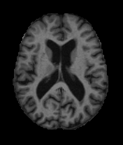
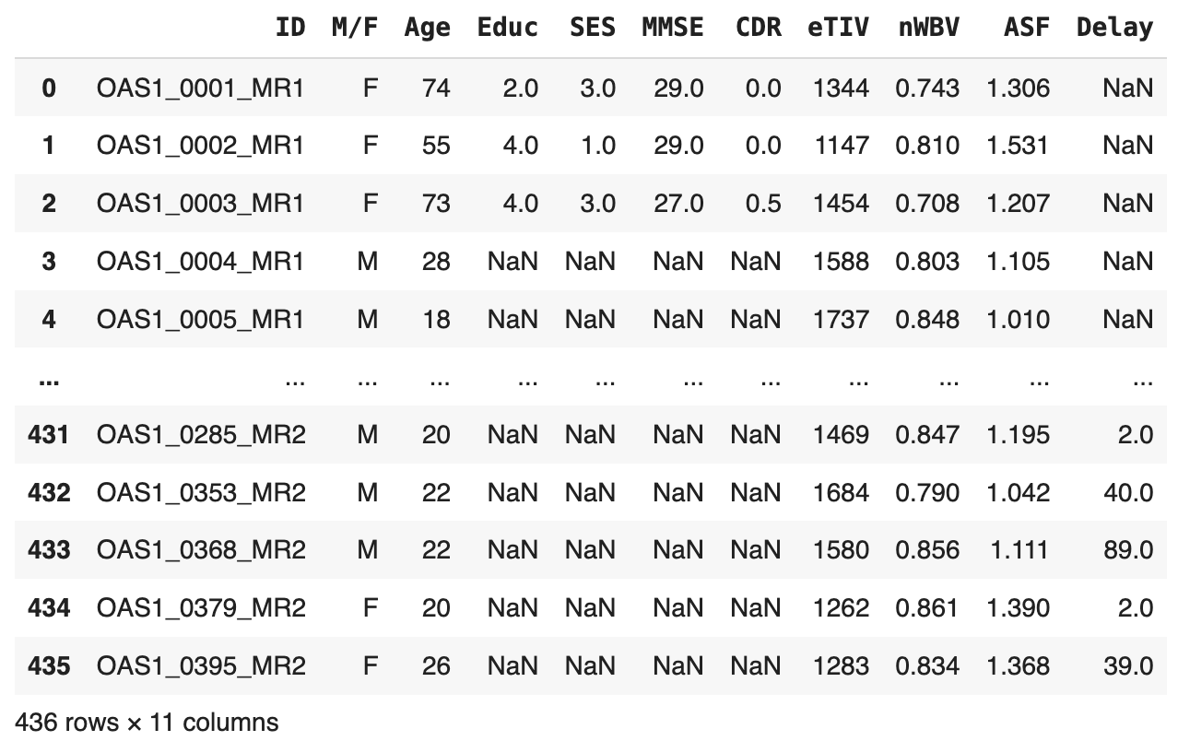
OASIS-1 Data
MRI Data
GIFs of masked, gain-field corrected, transverse MRI scans of the brain
Demographics Data
Gender (M/F)
Handedness (Hand)
Age
Education (Educ)
Socioeconomic status (SES)
Clinical Data
Mini-Mental State Examination (MMSE)
Estimated total intracranial volume (eTIV) (mm3 )
Atlas scaling factor (ASF)
Normalized whole brain volume (nWBV)
Clinical Dementia Rating (CDR; 0 = nondemented; 0.5 = very mild dementia; 1 = mild dementia; 2 = moderate dementia)

Slide 6
OASIS-1 Data
MRI Data
GIFs of masked, gain-field corrected, transverse MRI scans of the brain
Demographics Data
Gender (M/F)
Handedness (Hand)
Age
Education (Educ)
Socioeconomic status (SES)
Clinical Data
Mini-Mental State Examination (MMSE)
Estimated total intracranial volume (eTIV) (mm3 )
Atlas scaling factor (ASF)
Normalized whole brain volume (nWBV)
Clinical Dementia Rating (0 = nondemented; 1 = Demented)
Preserve all N/A values

Slide 7
03
Model for
Demographic & Clinical Data

Slide 8
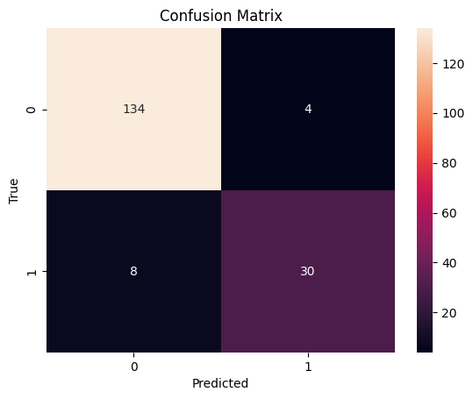
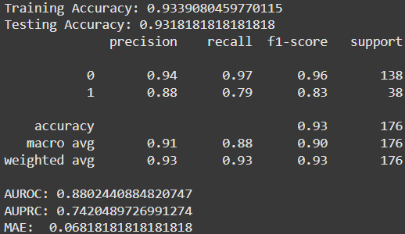
Model for Demographic & Clinical Data
XGBoost model is the best performing model overall
Uses the binary classification
Previously, XGBoost was overfitting on the training data, producing 100% accuracy
Adding L1 and L2 regularization reduced overfitting, but didn’t eliminate it.

Slide 9
04
Model for MRI Images

Slide 10
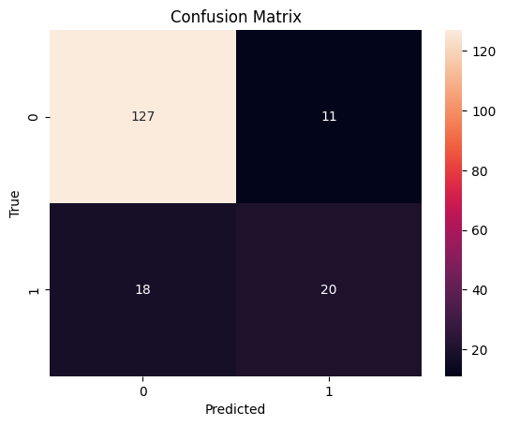
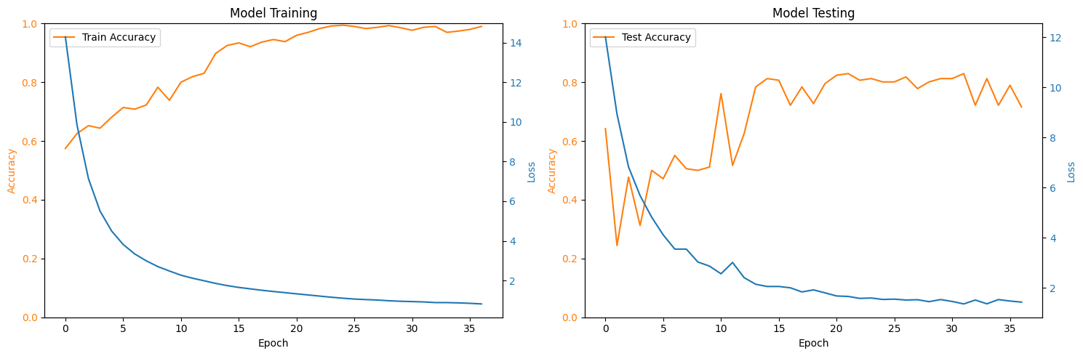
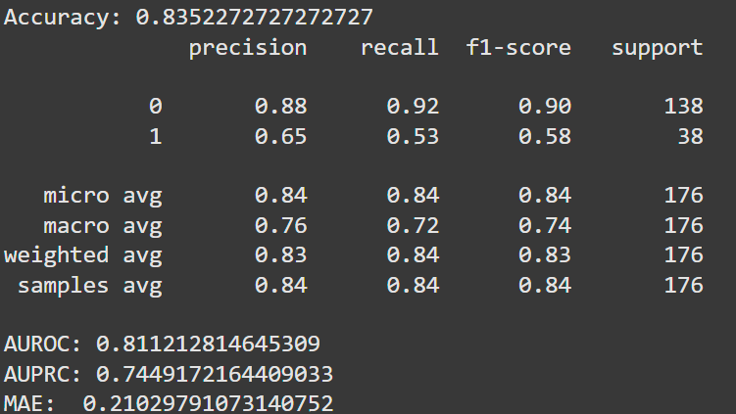
Model for MRI Images
Previous model was overfitting

Slide 11
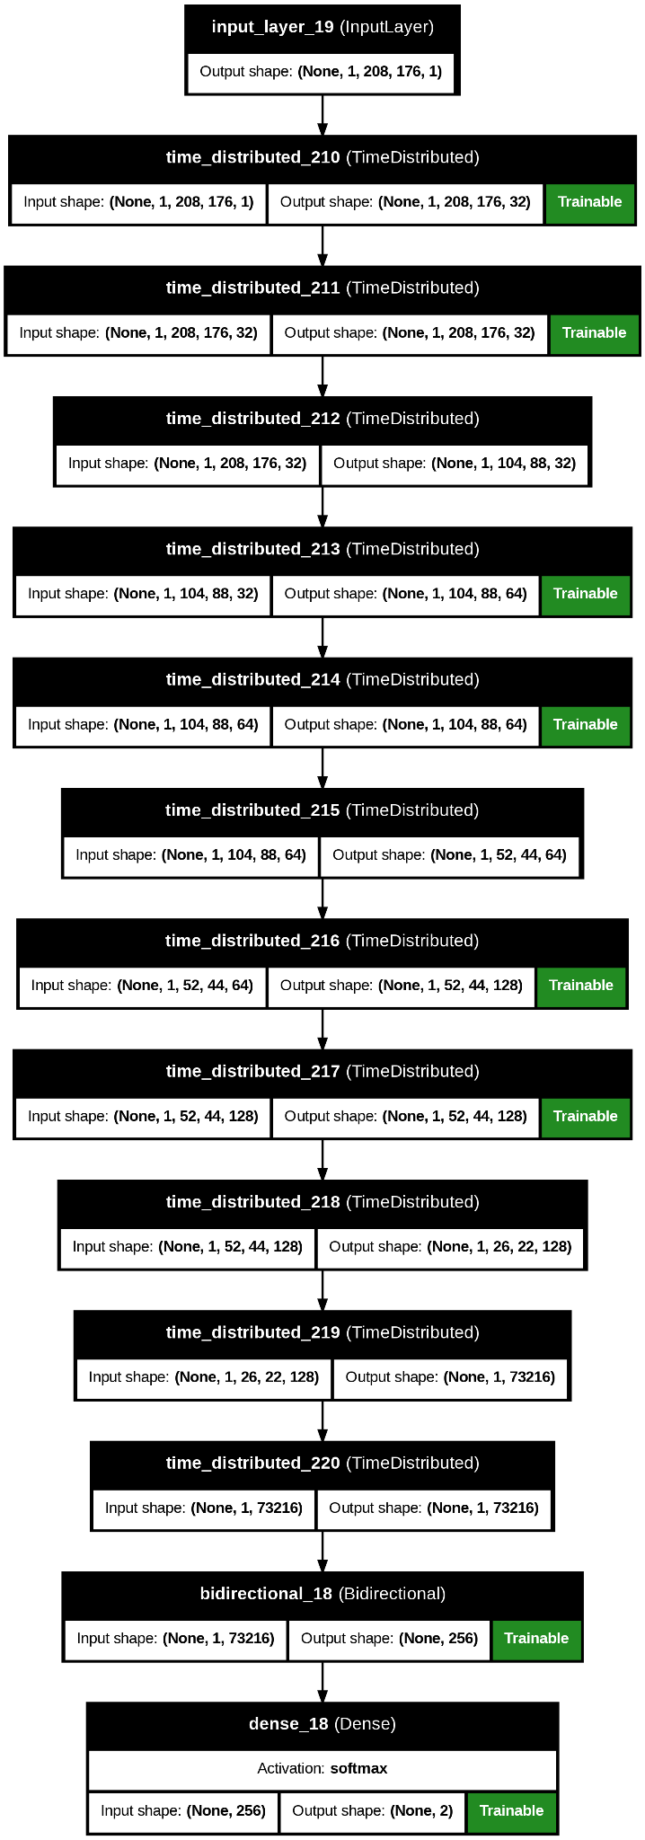
Model for MRI Images
Structurally, remains unchanged
3 Convolutional Layers
3 Max Pooling Layers
3 Batch Normalization Layers
1 Flatten, Dropout, Bidirectional GRU layer
Reduced overfitting and improved generalization using:
Data Augmentation
Early Stopping
Model Checkpoints
Reducing Learning Rate on Plateau
Dropout Layer
Class weights (0: 0.2018; 1: 0.7982)

Slide 12
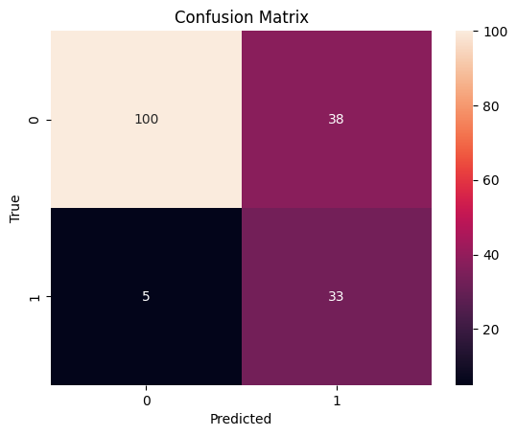
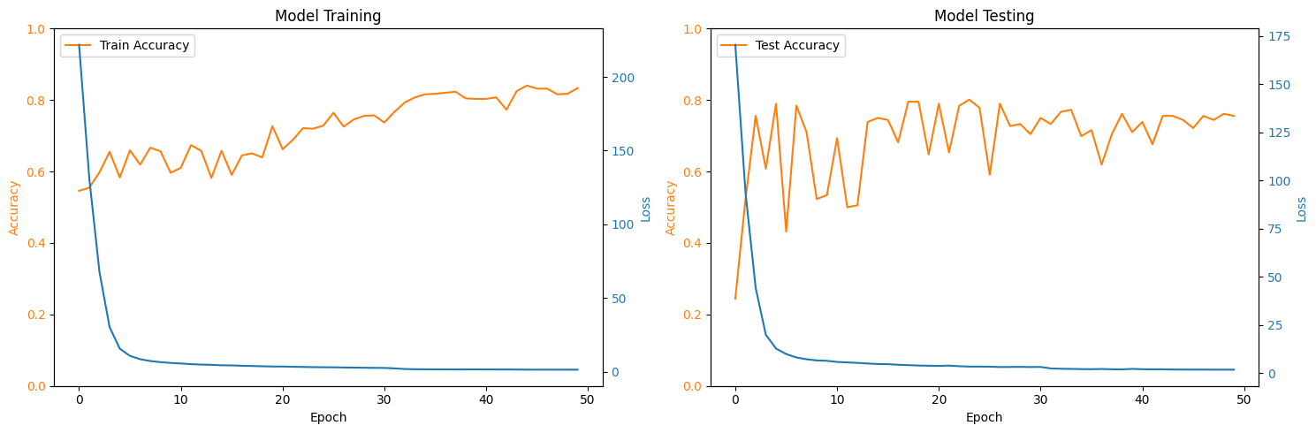
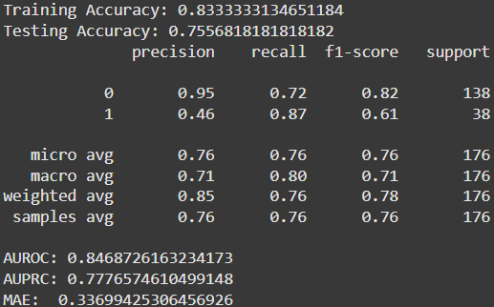
Model for MRI Images
New model has significantly lower overfitting issue, but lower performance and stability.
Marginally better AUROC and AUPRC

Slide 13
05
Combining: Ensemble Gate

Slide 14
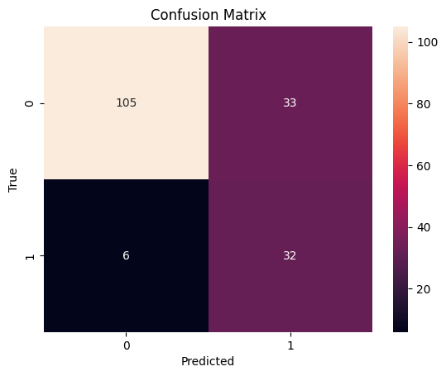
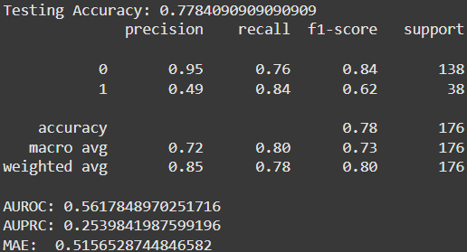
Ensemble Gate
Significantly worse performance than anticipated
Accuracy was ~66% with previous totally overfit XGBoost model
New model is better, but worse than both CNN and XGBoost individually; Result of XGBoost still overfitting

Slide 15
06
Combining: Concatenation

Slide 16

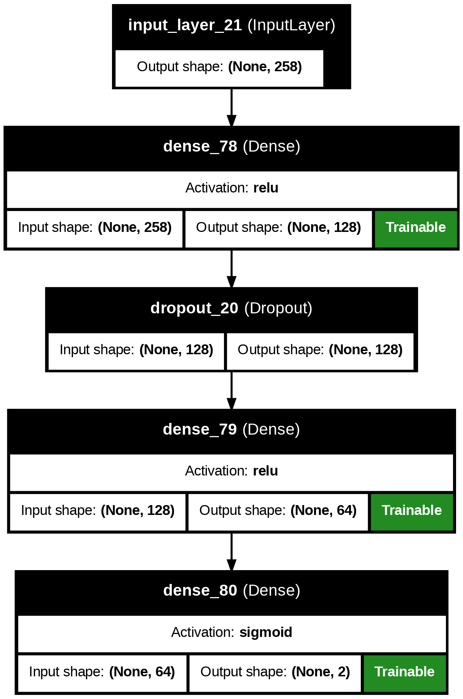
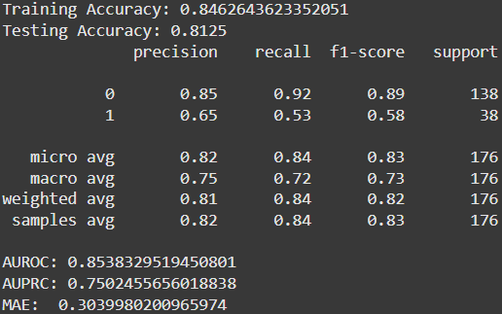
Concatenation
Using a Neural Network Classifier still remains the best method of concatenation.
Slight improvement in most metrics over CNN
Output
Final Neural Network Classifier
CNN features
XGBoost features

Slide 17
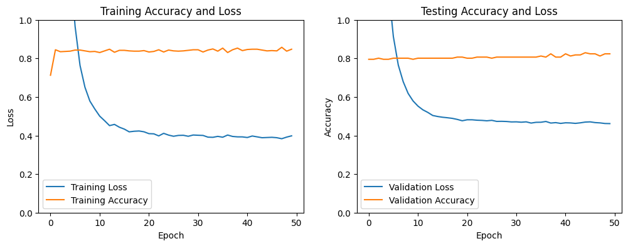
Concatenation
Using a Neural Network Classifier still remains the best method of concatenation.
Slight improvement in most metrics over CNN
Overfitting issue - stems from XGBoost

Slide 18
07
Future Improvements

Slide 19
Future Improvements
More DATA‼️

Slide 20
THANK YOU

